Slide 1

Hospital Database & Visualization Dashboard
A Comprehensive Approach to Design, Implementation, and Insight
By
Prajna Ganji, Shiva, Neetika Upadhyay and Maruta Zalane

Slide 2
Project Overview
Project Objective
To design a normalized hospital database system capable of storing and managing healthcare data effectively.
Scope
Includes database schema design, synthetic data generation, SQL-based data analysis, and performance insights.
Key Components
Entity-Relationship Diagram (ERD)
Table creation with constraints and relationships
Data population using Python Faker
SQL queries for operational analysis
Use Case
Designed to support hospital administration, improve decision-making, and optimize healthcare delivery.
Project Deliverable
A functional and efficient hospital database and Power BI Dashboard providing insights into hospital performance

Slide 3
Goals & Objectives
Goal 1: Design a normalized and relational hospital database
Create an ERD that defines core hospital entities and their relationships
Implement tables with appropriate data types, constraints, and relationships
Goal 2: Simulate real-world hospital operations through synthetic data
Generate realistic synthetic data using Chat GPT(Python Faker Library)
Write and execute SQL queries to extract actionable insights
Goal 3: Enable meaningful data-driven insights for hospital management
Designing the dashboard related to appointments, departments, Patients etc.
Create visuals and performance metrics using Power BI

Slide 4
Tools & Technologies
Database
MS SQL Server
Data Generation
ChatGPT-4 that used Python, Faker Library
Analysis & Queries
Power BI
ERD tool
Visualization
Structured Query Language (SQL)
Mermaid

Slide 5
Methodology
Data modeling
Data Generation
Data Transformation
Dashboard Development

Slide 6
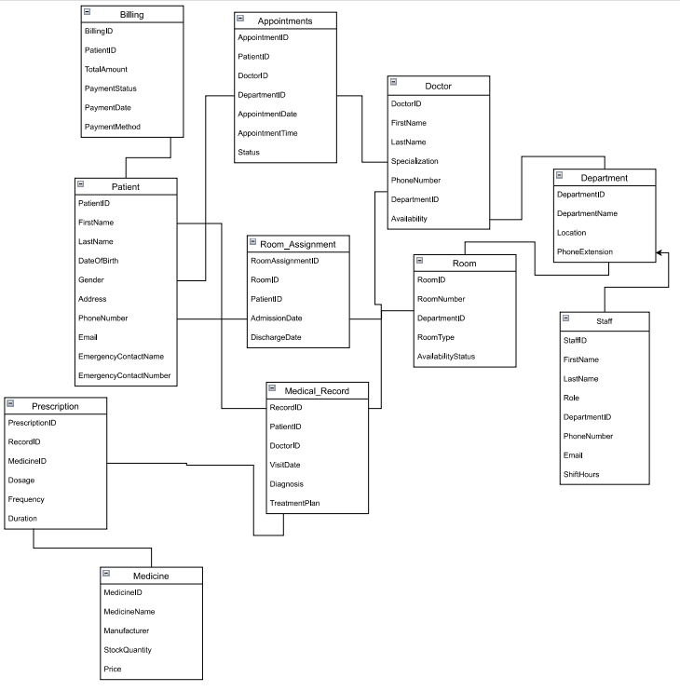
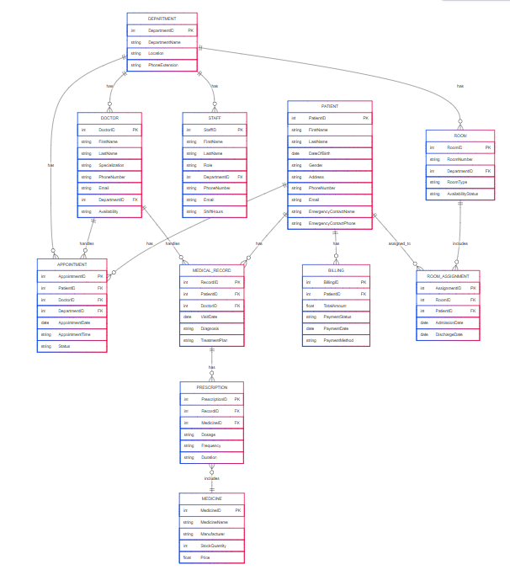
Data Modeling (ER Diagram)
Conceptual Diagram
Physical Diagram

Slide 7
Synthetic Data Generation
Approach Using ChatGPT - 4
Prompt Engineering Process
Iterative Improvements
Data Validation
Used GPT-4 to generate synthetic data for all tables in the hospital database.
Designed structured prompts to simulate realistic records for Patients, Doctors, Appointments, etc.
Initially received random, disconnected data without consistency across related entities.
Refined and expanded prompts:
Started with 12 rules, increased to 20+ rules for better data control
Added constraints and formatting rules (e.g., valid dates, department-doctor mapping)
Repeated prompt iterations across multiple tables to preserve referential integrity.
Ran multiple iterations, learning from output mismatches.
Gradually achieved datasets with valid primary-foreign key relationships (e.g., matching PatientID in Appointments, valid Room assignments).
Referential Integrity Check
Ensured all foreign key relationships are valid.
Data Type Validation
Confirmed all columns use the correct types
Logical Validations:
Discharge date ≥ Admission date
Billing amounts ≥ 0
Uniqueness Checks
Verified no duplicates in primary keys
Null Value Check
Checked mandatory fields are not null.

Slide 8



Data Transformation – SQL Server to Power BI
SQL Server
Power BI
Dashboard
Created and populated normalized hospital tables with synthetic data.
Created SQL queries & views using Joins to ensure clean, relational data for business questions.
Connected using Power BI SQL Server connector
Data imported with minimal transformation in Power BI
DAX measures added for insights
Created visuals to explore hospital insights
Notes:
https://creativecommons.org/licenses/by/4.0/ - free to share and copy and redistribute the material in any medium or format for any purpose, even commercially.
Attribution — You must give appropriate credit , provide a link to the license, and indicate if changes were made . You may do so in any reasonable manner, but not in any way that suggests the licensor endorses you or your use.

Slide 9
Dashboard Development
Hospital Performance Dashboard
Target User- Hospital Executives (CEO, Leadership Team, Decision Makers)
Purpose- High-level KPIs, strategic insights, overall performance snapshot.
Patient & Appointment Overview Dashboard
Doctor Availability & Workload Dashboard
Financial Overview Dashboard
Prescriptions Overview
Room Utilization Overview Dashboard
Target User
Hospital Administrators
Purpose
Patient volume, appointment trends, cancellations.
Target User
Medical Directors & Doctors
Purpose
Scheduling, workload distribution, availability tracking.
Target User
Finance Department
Purpose
Revenue, expenses, top-earning department, billing efficiency.
Target User
Pharmacy Department
Purpose
Medication trends, prescribing habits, potential overuse alerts
Target User
Facility Management
Purpose
Room occupancy, usage efficiency, turnover rates.

Slide 10
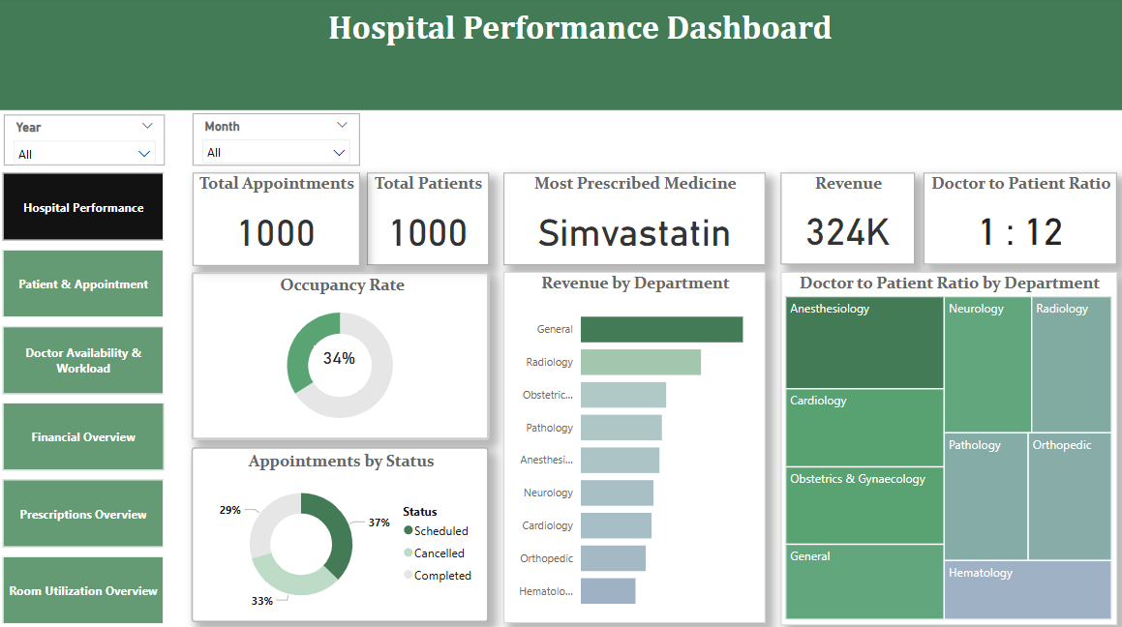
Hospital Performance Overview Dashboard

Slide 11
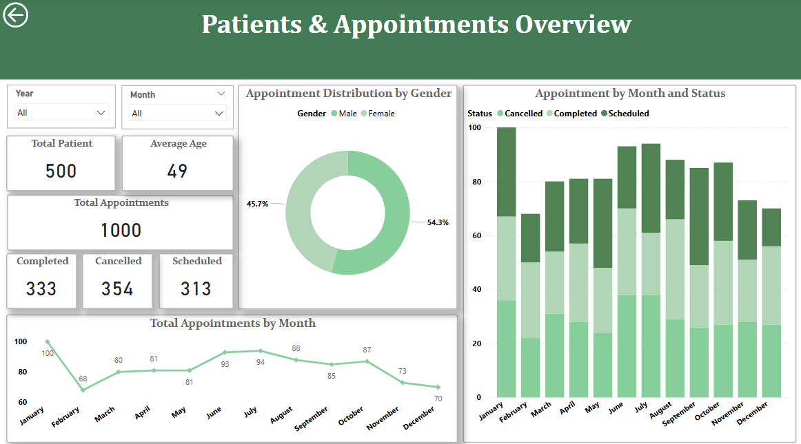
Patient and Appointment Overview Dashboard

Slide 12
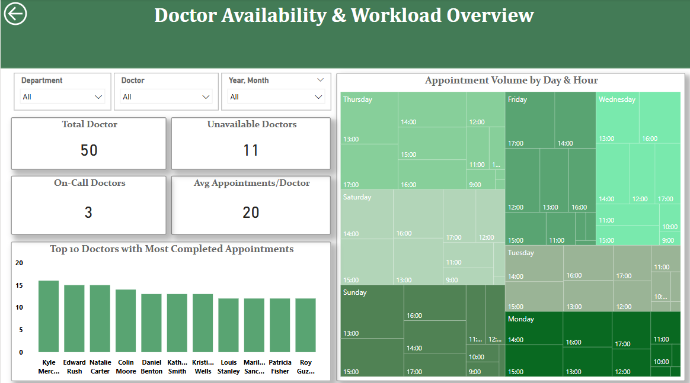
Doctor Availability and Workload Dashboard

Slide 13
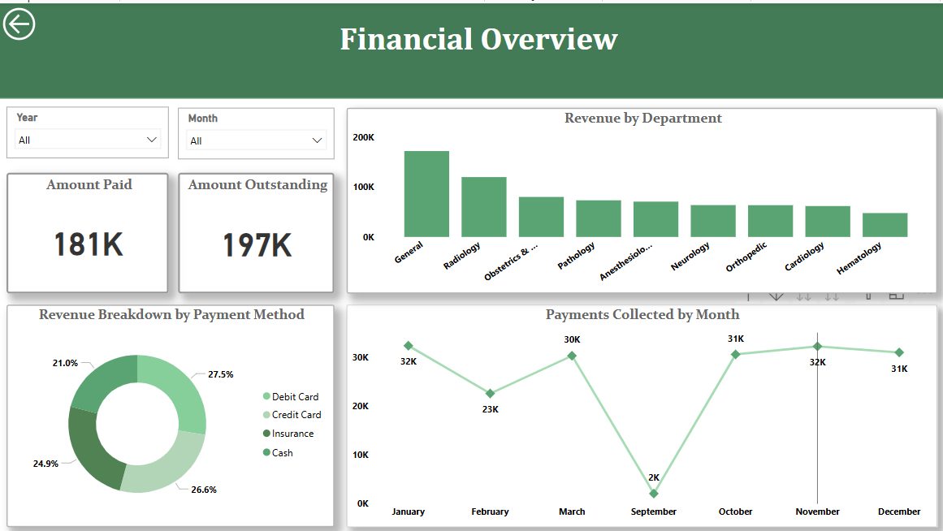
Financial Overview Dashboard

Slide 14
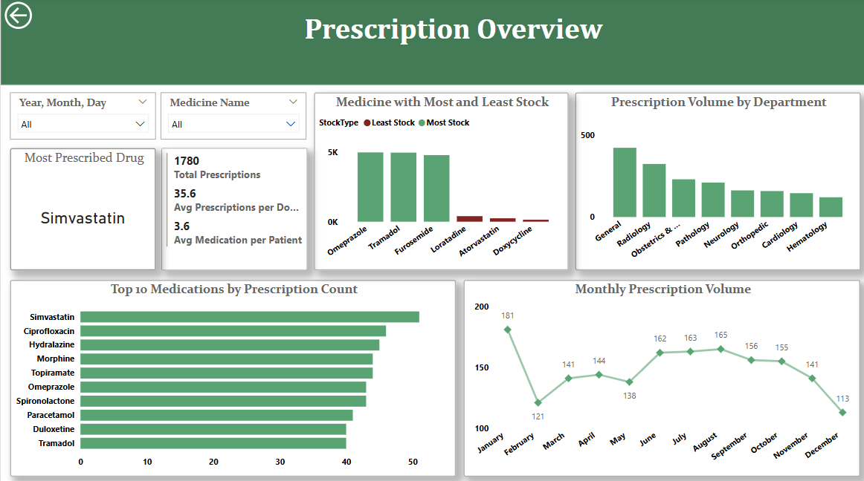
Prescriptions Overview Dashboard

Slide 15
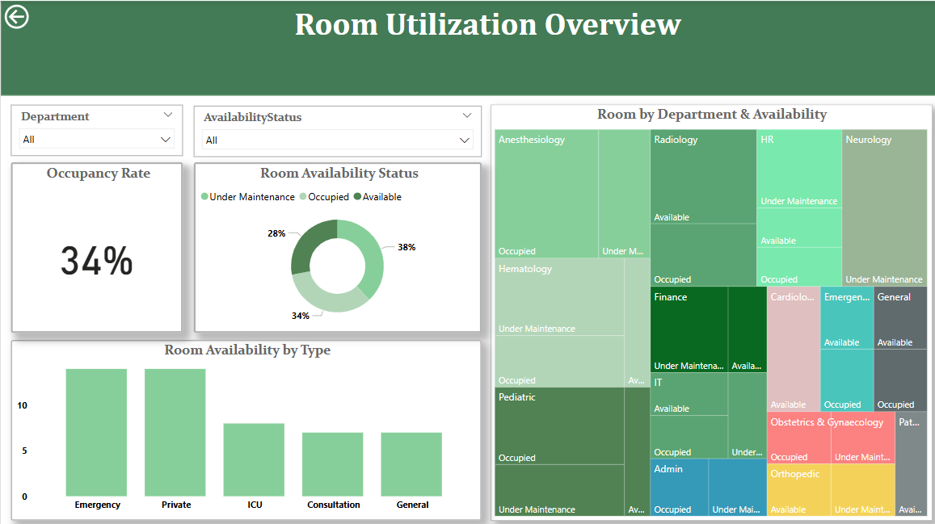
Room Utilization Overview Dashboard

Slide 16
Challenges & Limitations
Data Generation & Referential Integrity Challenges
SQL-to-Power BI Integration
Generating large volumes of realistic yet relational synthetic data was time-consuming.
Early GPT-4 outputs had random, disconnected values, breaking referential integrity.
Required multiple prompt refinements and iterations to generate consistent, rule-based data.
Needed to write custom SQL queries and views to pre-aggregate and clean data before import.
Power BI sometimes inferred incorrect relationships requiring manual adjustment.

Slide 17
Learnings & Takeaways
This project strengthened our end-to-end understanding of data systems—from database design and synthetic data creation to real-time analytics and reporting.
1. Technical Learnings
Gained hands-on experience in designing Entity-Relationship (ER) diagrams.
Improved SQL skills for data generation, validation, and analytical querying.
Learned to use prompt engineering with GPT-4 to generate high-quality synthetic data.
Developed data transformation workflows connecting SQL Server with Power BI.
2. Analytical & Modeling Skills
Built a relational data model with real-world hospital operations in mind.
Understood the importance of referential integrity and data consistency for meaningful analysis.
Created and optimized DAX measures and visualizations in Power BI.
3. Problem Solving & Iteration
Discovered how iterative refinement (in prompts and design) leads to better outcomes.
Adapted quickly to challenges in data inconsistencies and modeling logic.

Slide 18
Conclusion
This project demonstrates how integrated data systems and thoughtful design can drive better healthcare management, resource planning, and patient experience analysis.
Project Summary
Successfully designed and implemented a relational hospital database with normalized tables and strong referential integrity.
Used GPT-4 and prompt engineering to generate realistic synthetic data across multiple hospital operations.
Connected the SQL Server database to Power BI, transforming and modeling data to build insightful reports.
Extracted valuable insights using SQL queries and Power BI dashboards, helping simulate real-world healthcare decision-making.

Slide 19
Appendix (1)
Database Schema
Table Name | Primary Key | Foreign Keys | Purpose
Patients | PatientID |  | Holds patient demographic information
Doctors | DoctorID | DepartmentID | Contains doctor information and department link
Departments | DepartmentID |  | Stores hospital department details
Appointments | AppointmentID | PatientID, DoctorID, DepartmentID | Records patient-doctor appointments
MedicalRecords | RecordID | PatientID, DoctorID, AppointmentID | Stores diagnosis and treatment plans
Prescriptions | PrescriptionID | RecordID, MedicineID | Links medicines to medical records
Medicines | MedicineID |  | Contains medicine details and stock information
Billing | BillingID | PatientID | Manages billing and payment status
Staff | StaffID | DepartmentID | Stores non-doctor hospital staff details
Rooms | RoomID | DepartmentID | Manages room details and availability
Rooms Assignment | AssignmentID | PatientID, RoomID | Tracks patient room assignments and date

Slide 20

Appendix (2)
Sample Snippets of Data Generated
Patient Table
Staff Table
Doctor Table
Appointment Table
Department Table

Slide 21
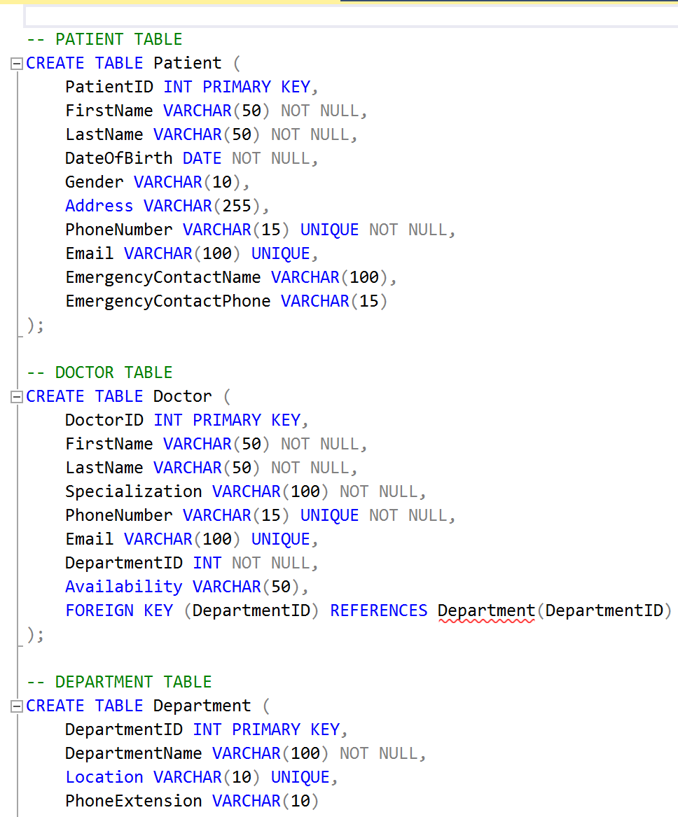
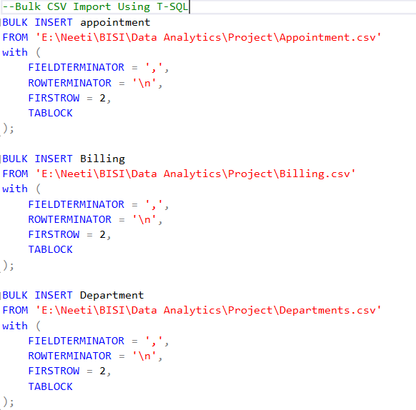
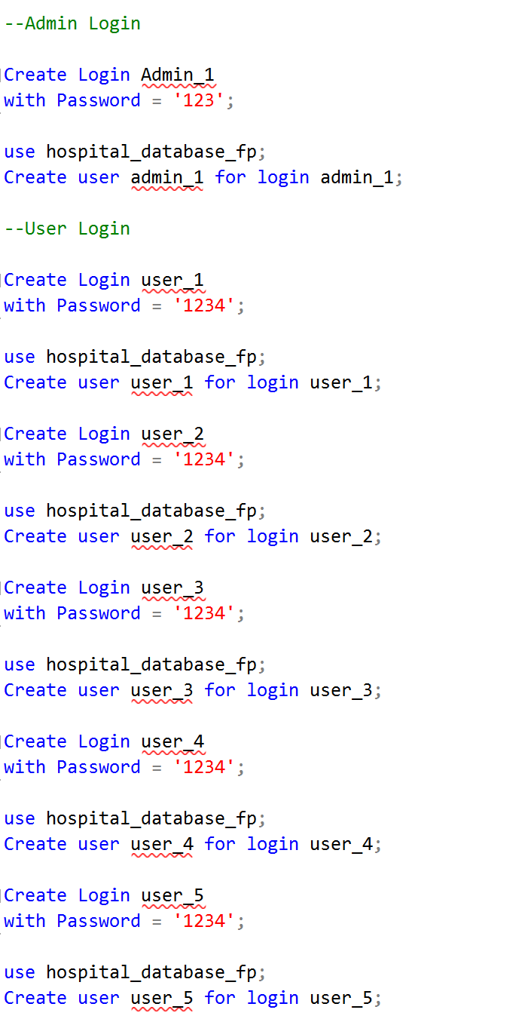
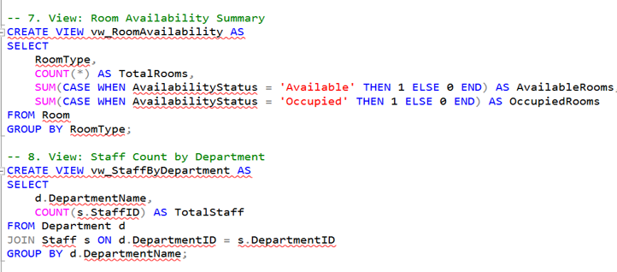
Appendix (3)
DDL
DML
User Roles and Access Control
Views for Business Question

Slide 22

Any questions?​

Slide 23
Thank you for your attention!​

